Slide 1
DEVELOPMENT PLAN
Meeting Intelligence
Prototype
Turning uploaded sales-meeting recordings into transcripts, customer insights,
a rep scorecard, and human-approved knowledge-pack updates.
Self-hosted GPU default
Single-user prototype
English · Hindi · Hinglish
Prepared for engineering kickoff · Phase 0 starts with repo & local platform

Slide 2
OBJECTIVE
From a raw recording to five trustworthy outputs
1
Timestamped, speaker-labelled transcript
WhisperX diarization aligned to word-level timing.
2
User-confirmed speaker roles
Anonymous labels only become real roles after human confirmation.
3
Evidence-based customer insights
Pain points, objections, questions, confusion, interest, follow-ups.
4
Evidence-based sales scorecard
Product knowledge, clarity, discovery, objection handling.
5
Human-approved knowledge-pack updates
Versioned Markdown diffs — never auto-merged.
Default deployment: self-hosted GPU server. Architecture must also permit managed-cloud deployment later.
Meeting Intelligence Prototype
2

Slide 3
FIXED PRODUCT DECISIONS
Ground rules the build must respect
Meeting type
LLM
Recorded, in-person meetings uploaded after the meeting
Self-hosted Gemma 4 by default; deployment-specific config
Speakers
Retrieval
2–8 expected speakers; count is optional input
PostgreSQL + pgvector over Markdown knowledge chunks
Languages
Persistence
English, Hindi, and Hinglish
PostgreSQL for app data; local filesystem for audio
User model
Async jobs
Single-user prototype; that user can access all meetings
Redis + Celery
Diarization
Retention
WhisperX gives anonymous labels only — never real identities
Unsaved meetings deleted after 30 days; saved ones persist
Role assignment
Knowledge updates
Gemma 4 infers roles; user must confirm, swap, or edit first
Human approval only; applied as versioned Markdown diffs
Meeting Intelligence Prototype
3

Slide 4
USER WORKFLOW
Ten steps from upload to approved knowledge update
1
Upload an audio recording
6
UI shows progress: uploaded → transcribing → awaiting roles → analysing → complete
2
Optionally add purpose, participants, expected speaker count
7
Gemma 4 proposes roles; user confirms, swaps, or edits
3
Upload or select the required Markdown knowledge pack
8
Background analysis retrieves knowledge chunks and produces results
4
System stores audio and creates a background job
9
Results page shows transcript, insights, scorecard, proposals
5
WhisperX transcribes, aligns, and diarizes speakers
10
User approves/rejects proposals; approved ones version the knowledge pack
Meeting Intelligence Prototype
4

Slide 5
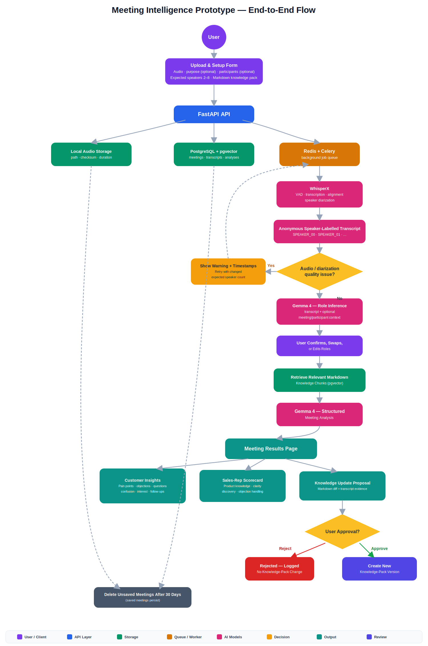
ARCHITECTURE
End-to-end system flow
Meeting Intelligence Prototype
5

Slide 6
CORE DATA MODEL
Nine entities anchor the schema
1
knowledge_packs
2
knowledge_pack_versions
3
knowledge_chunks
Name, current version, source Markdown
Version number, Markdown content, approval metadata
Heading, content, embedding vector, ordinal
4
meetings
5
speaker_labels
6
transcript_segments
Audio path, checksum, status, retention deadline, saved flag
WhisperX label, inferred + confirmed role, confidence
Speaker, start/end time, text, word-level data
7
analyses
8
knowledge_proposals
9
job_events
Schema version, structured JSON result, model metadata
Proposed diff, evidence references, approval status
Stage, status, message, timestamps, retry count
A deletion job removes local audio + all linked rows for expired, unsaved meetings.
Meeting Intelligence Prototype
6

Slide 7
STRUCTURED ANALYSIS CONTRACT
Gemma returns validated JSON, never display-ready prose
Role Inferences
Customer Insights
Sales Assessment
Knowledge Proposals
Speaker label + inferred role
Category: pain point, objection, question, interest, confusion, follow-up
4 dimensions, each 0–100
Title + proposed Markdown change
Confidence + rationale
Summary + evidence timestamps/quotes
Rationale + transcript evidence
Evidence + confidence
Transcript evidence
Confidence
Knowledge-pack refs + coaching actions
Target knowledge-pack section
A failed schema validation retries with a repair prompt, then marks the analysis failed if still invalid. Unsupported conclusions are never rendered as fact.
Meeting Intelligence Prototype
7

Slide 8
QUALITY & SAFETY BEHAVIOUR
Guardrails before, during, and after analysis
✓
Detect and surface poor audio, overlapping speech, or uncertain diarization
✓
Include affected timestamps in every quality warning
✓
Allow retry with a changed expected speaker count (2–8)
✓
Require acknowledgement before analysis proceeds with a warning
✓
Never run sales/customer analysis until roles are confirmed
✓
Preserve transcript evidence and knowledge references for every result
✓
Never auto-merge knowledge proposals
Meeting Intelligence Prototype
8
8

Slide 9
DELIVERY PHASES · 1 OF 2
Phase 0 — Phase 3
0
Repository & Local Platform
Monorepo, Docker Compose, migrations, health checks, lint/format/test commands.
1
Meeting Ingestion & Lifecycle
Upload UI/API, setup form, checksums, job creation, manual + 30-day retention delete.
2
WhisperX Transcription & Diarization
Worker adapter, speaker-count bounds, quality warnings, retry, speaker-grouped UI.
3
Role Inference & Confirmation
Gemma role prompt, validation, confirm/edit/swap UI, gate on downstream analysis.
Meeting Intelligence Prototype
9

Slide 10
DELIVERY PHASES · 2 OF 2
Phase 4 — Phase 7
4
Knowledge-Pack Retrieval
Markdown versioning, heading-aware chunking, embeddings, pgvector retrieval, version pinning.
5
Customer & Sales Analysis
Gemma prompts + Pydantic contracts, evidence links, knowledge citations, results page.
6
Knowledge Proposals & Review
Proposal generation, diff preview, approve/reject, immutable versions, rollback.
7
Evaluation, Deployment & Hardening
Curated multilingual eval set, GPU/server docs, self-hosted + managed-cloud guides, backups.
Meeting Intelligence Prototype
10

Slide 11
ACCEPTANCE CRITERIA
What “done” looks like for V1
✓
Accepts in-person recordings with an optional 2–8 speaker expectation
✓
Unsaved meetings auto-delete after 30 days; saved meetings are excluded
✓
Supports English, Hindi, and Hinglish, with documented alignment limits
✓
Users can retry poor diarization with a different speaker count
✓
Never treats anonymous labels as real roles without user confirmation
✓
Knowledge-pack changes require explicit approval and version history
✓
Every customer insight and score has timestamped transcript evidence
✓
End-to-end success on 10–20 representative recordings, no manual fixes
✓
Every product-knowledge assessment cites relevant knowledge-pack content
Meeting Intelligence Prototype
11

Slide 12
OUT OF SCOPE FOR V1
Deliberately deferred
Live meeting capture or meeting-platform bots
✕
Multi-user accounts, permissions, and tenant isolation
✕
Manual transcript editing
✕
Automatic knowledge-base updates
✕
Claims of perfect diarization, transcription, role ID, or sales evaluation
✕
General-purpose meeting types beyond the sales-focused workflow
✕
Meeting Intelligence Prototype
12

Slide 13
RECOMMENDED FIRST AGENT TASK
Build Phase 0 only
Create the monorepo and Phase 0 Docker Compose stack. Do not begin UI or model
integration until environment, migrations, health checks, and local test commands
are documented and working.
web/
api/
worker/
infra/
docs/
Done when a new developer can start the stack locally and create a database migration.

